Slide 1


MINI PROJECT ON MOBILE STORE MANAGEMENT SYSTEM
BATCH MEMBERS DETAILS:-
17121A1210-B.PRATHYUSHA
17121A1211-C.KARTHIK NAIDU
17121A1212-C.SRAVANI
17121A1213-C.KRANTHI KUMAR
17121A1214-C.NAGASAI
17121A1215-D.SASHI KUMAR
17121A1216-D.VENKATESH CHOWDARY
17121A1217-D.PUSHPANJALI
17121A1218-D.SUMEDH
Department of IT,Sree vidyanikethan engineering college

Slide 2
TABLE OF CONTENT:-
S.NO | CONTENT | SLIDE NUMBER
1. | ABSTRACT AND FEATURES | 3-4
2. | INTRODUCTION | 5
3. | MODULES AND DESCRIPTION | 6-11
4. | DESIGN OF PROJECT | 12-17
5. | RESULT | 18-24
6. | CONCLUSION | 25
7. | HARDWARE AND SOFTWARE REQUIREMENTS | 26
8. | ROLES | 27
9. | REFERENCES | 28

Slide 3
ABSTRACT:-
Mobile Store Management System is specially designed for the purpose of adding mobile’s records in mobile showrooms.
It’s easy to operate and understand by users. The design is simple and the user won’t find it difficult to use and navigate.
The pogramme have following facilities Adding a mobile record,Searching a mobile record,View a Mobile Record,Edit a mobile record ,Delete a mobile record
The pogramme have following features Login System,Proper Validations,Password protected,Categories divided into Mobile brands,Fields such as Availability status, Quantity and Price are available

Slide 4
1.INTRODUCTION:-
The Mobile Store Management System is developed for desktop systems to facilitate mobile shop owners management of mobile details,which will include mobile phones.
It can be used efficiently for physically separated shops in different locations. This software will provide in a simple and easy to operate user interface, which can be managed by any user without having any depth knowledge of the computer system.
One can use this software to get a mobile’s report. Administrators can add data,search data,view data,edit data,delete data.
Therefore, creating an application with the basic requirement of low cost is essential for small organizations.

Slide 5
2.MODULES:-
There are five modules in this project.They are :
Adding mobile record
View mobile record
Search mobile record
Edit mobile record
Delete mobile record

Slide 6
MODULE 2.1:- ADDING MOBILE RECORD
Objective:-
The main objective is to add new mobile record.
In this module it shows various mobile brands(such as Apple,Nokia,Htc…..),so that it make easier to enter the data regarding to that brand.
Operations:-
Using getdata() reading mobile id,modelname,quantity,availability status,price.
Concepts:-
Files.
Structures.
Functions.

Slide 7
MODULE 2.2:- VIEW RECORD
Objective:-
Viewing the mobile records.
Operations:-
Displaying the various categories of mobiles id,quantity,modelname,price
and availability status.
Concepts:-
File concepts.
Control statements.

Slide 8
MODULE 2.3:- SEARCH MOBILE RECORD
Objective:-
Inorer to make the work easier to the user for viewing a particular mobile record,it can be done through the search module.
Operations:-
Searching Based on mobile id.
Searching based on model name.
Concepts:-
File handling concepts
control statement
Strings concepts.

Slide 9
MODULE 2.4:- EDITING MOBILE RECORD
Objective:-
Corrections regarding to the mobiles can be done through the edit module.
Operations:-
Reading the mobile id which wanted to edit and comparing mobile id with the existing id’s.if found editing it.
Concepts:-
File handling concepts
Checkid function.
Returnfunc function.

Slide 10
MODULE 2.5:- DELETING MOBILE RECORD
Objective:-
A mobile record is removed using this delete module.
Operations:-
Reading the mobile id and comparing with the existing id’s.if it found deleting the record.
Concepts:-
File concepts.
Control staments .
Relational operator.

Slide 11
3.DESIGN OF PROJECT:-
start
password
mainmenu
1
y
Add record
n
2
y
View record
n
3
y
Search record
n
4
y
Edit record
n
5
y
Exit
Delete record
n
Fig 3.0
6
Close application

Slide 12
3.1:-ADD RECORD
Select brand
Mobile id
Mobile name
Availability
Quantity
Price
y
n
Mainmenu
Fig 3.1

Slide 13
3.2:-VIEW RECORD
View record
Displays Mobile id
Displays Mobile name
Displays Availability
Displays Quantity
Displays Price
Mainmenu
Fig 3.2

Slide 14
3.3:-SEARCH RECORD
Search record
Search based on mobile name
T
Displays Mobile id
T
Search based on mobile id
F
F
Displays Mobile name
Displays Availability
Displays Quantity
Displays Price
y
n
Mainmenu
Fig 3.3

Slide 15
3.4:-EDIT RECORD
F
Enter mobile id
T
New Mobile name
New Availability
New Quantity
New Price
Y
N
Mainmenu
Fig 3.4

Slide 16
3.5:-DELETE RECORD
Enter mobile id
Record deleted
Delete anymore
y
n
Mainmenu
Fig:3.5

Slide 17
RESULT:-
This system is very simple in design and to implement .This system requires very low system resources. 1.security of data. 2.user friendly and interactive 3.minimum time required.
This project main intention is to be more user friendly to the users who doesn’t have prior knowledge to this application.
Easy handling of huge amount of data regarding mobiles.

Slide 18
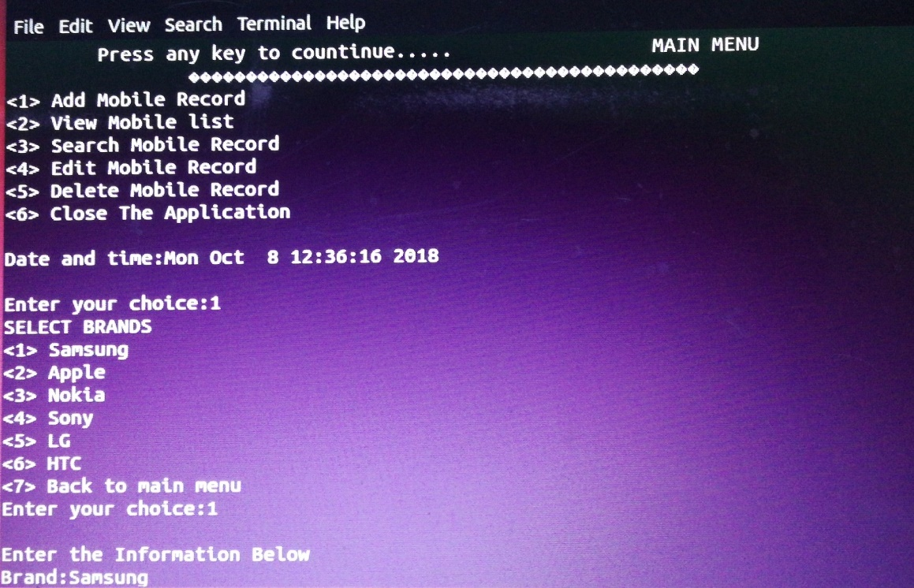
ADD RECORD:-
FIG 4.0 :adding mobile record

Slide 19
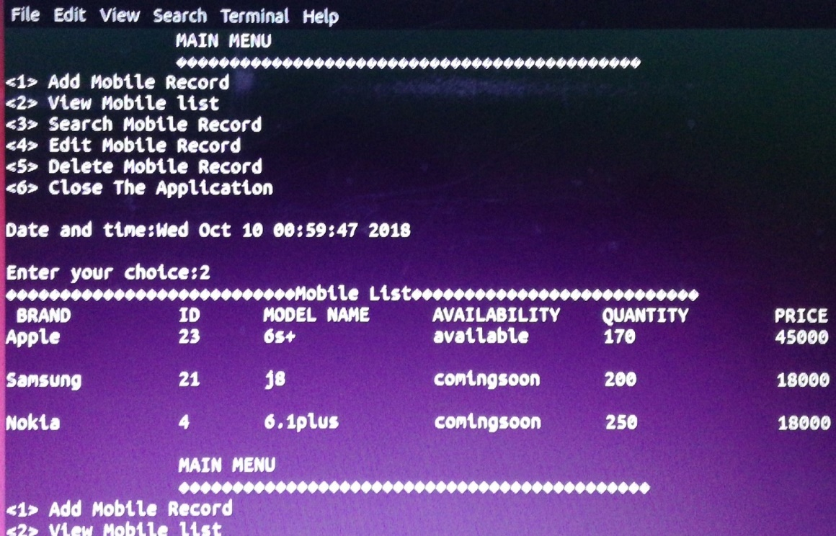
VIEW RECORD:-
FIG 4.1:viewing mobile record

Slide 20
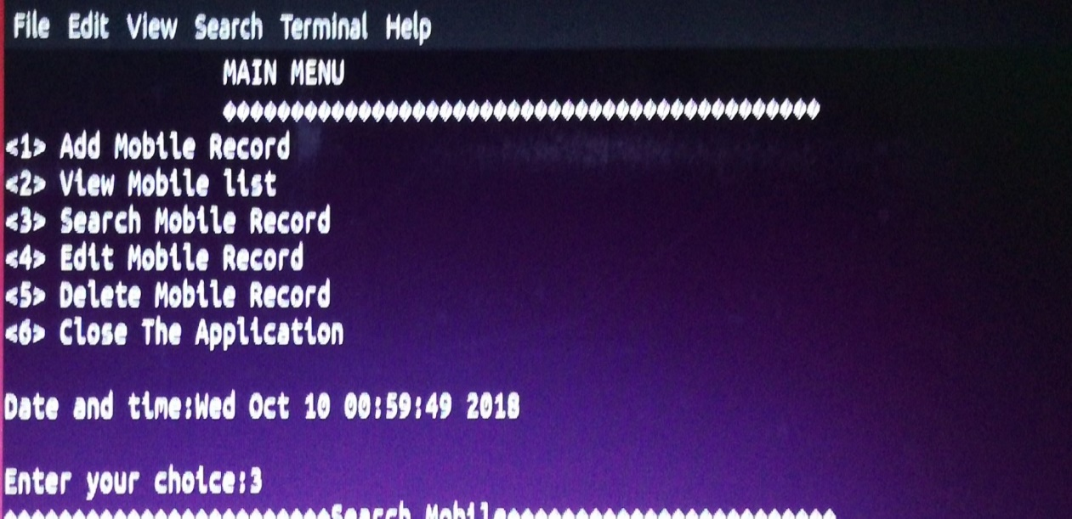
SEARCH RECORD:-
FIG 4.2:searching mobile record

Slide 21
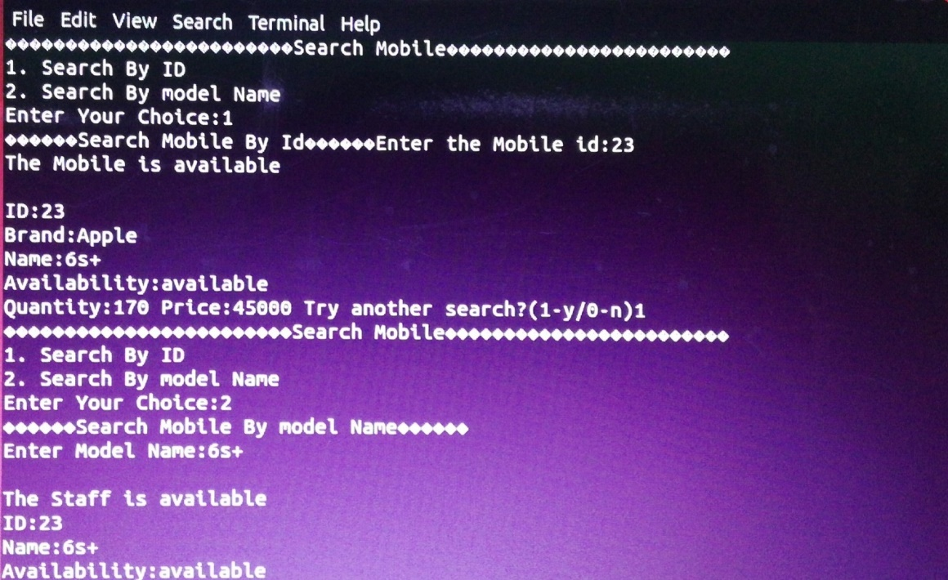
SEARCH CONTINUE….
FIG 4.3:searching mobile record

Slide 22
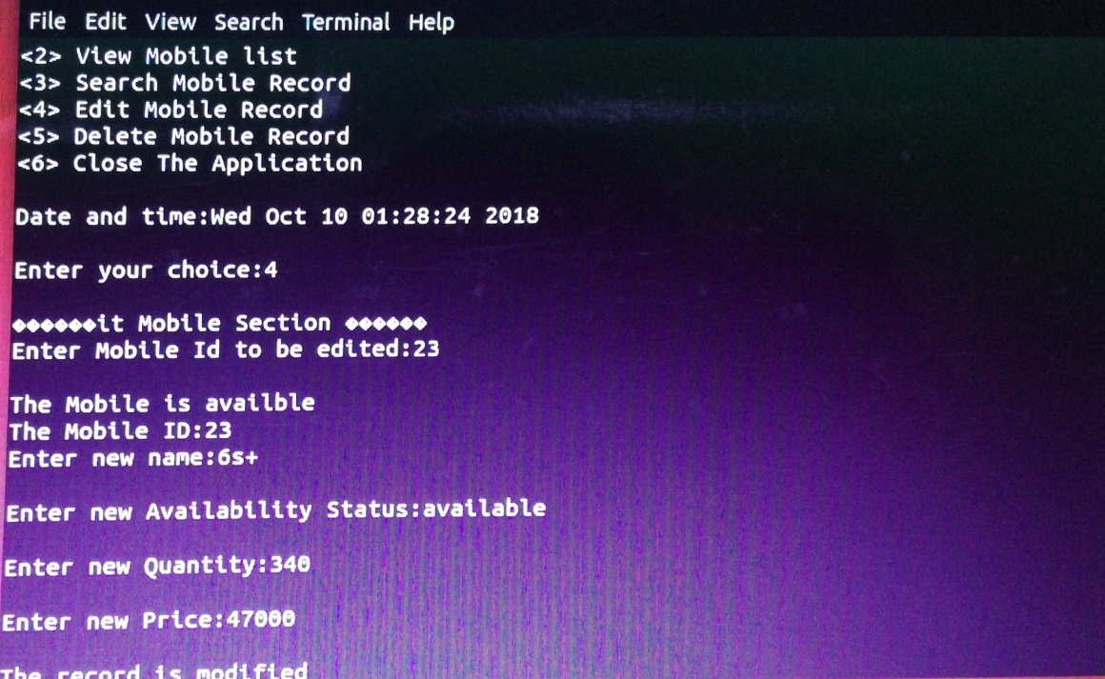
EDIT RECORD:-
FIG 4.4:editing mobile record

Slide 23
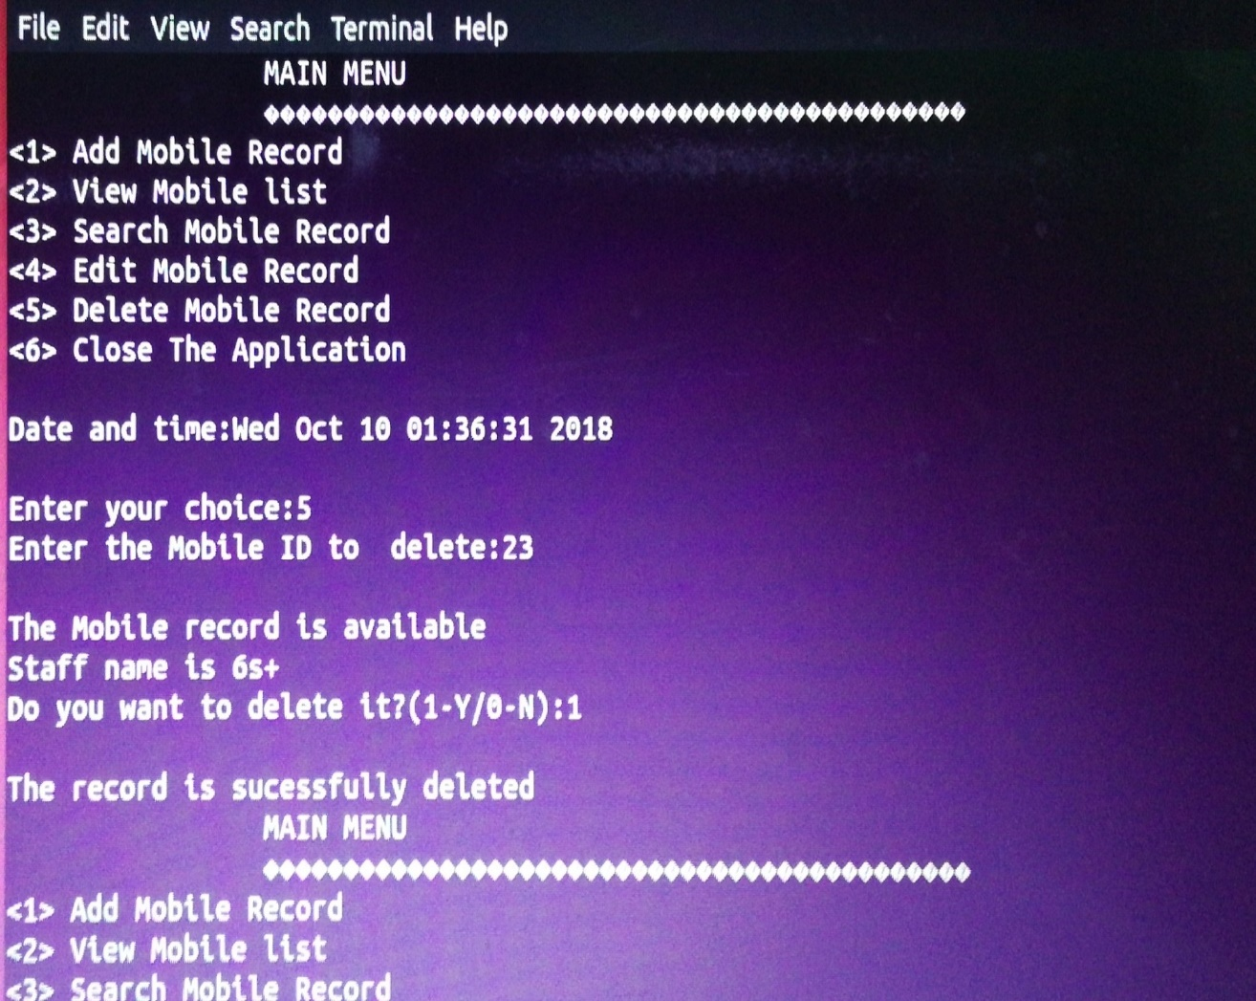
DELETE RECORD:-
FIG 4.5:deleting mobile record

Slide 24
CONCLUSION:-
From this project we conclude that this mobile store management application is very useful for the users where they can store the data regarding mobiles comfortably Without requirement of in-depth knowledge
This software has been made keeping it in mind that software is made for end users, not for programmers. So user friendliness keeping eye candy was first in the list. Wish this mobile store management system will serve satisfactory for which it is made.Easiness of mastering the whole process
With the use of linux terminal the process of controlling the whole system would be much easier and those can keep full control on the overall process without facing much trouble. With the user friendly GUI the software is very much user friendly and would be easy to use for anybody with a meager computer knowledge.

Slide 25
HARDWARE AND SOFTWARE EQUIPMENTS REQUIRED:-
Hardware Requirements:-
Processor:-Intel i3 64-bit operating system
RAM:4-GB RAM,
ROM:-1TB memory
Software Requirements:-
Linux environment such as Ubuntu.

Slide 26
ROLES IN PROJECT:-
S.NO | NAME OF THE STUDENT | ROLL NUMBER | ROLE
1. | B.PRATYUSHA | 17121A1210 | Module2 coding
2. | C.KARTHIK NAIDU | 17121A1211 | ppt preparation
3. | C.SRAVANI | 17121A1212 | ppt preparation
4. | C.KRANTHI KUMAR | 17121A1213 | Analyzer,tester
5. | C.NAGASAI | 17121A1214 | Ppt preparation
6. | D.SASHI KUMAR | 17121A1215 | Module4 coding
7. | D.VENKATESH CHOWDARY | 17121A1216 | Module5 coding
8. | D.PUSHPANJALI | 17121A1217 | Module1 coding
9. | D.SUMEDH | 17121A1218 | Module3 coding,Analyzer

Slide 27

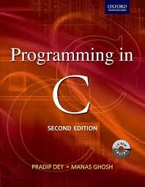

REFERENCES:-
TEXTBOOK:-
SUMITABHA DAS,YOUR UNIX:THE ULTIMATE GUIDE,TATA McGRAW-HILL,SIXTH EDITION,2007
PRADIP DEY AND MANAS GHOSH,PROGRAMING IN C,SECOND EDITION,OXFORD UNIVERSITY PRESS,2011.
RICHARD PETERSEN,LINUX:THE COMPLETE REFERENCE,TATA McGRAW-HILL,SIXTH-EDITION,2007.

Slide 28
THANK YOU SIR

